Slide 1


Predicting Sunday Night Football Matchups
Michelle Scott

Slide 2
Sunday Night Football (SNF)
Started on August 6, 2006
Weekly broadcasting of an NFL game on NBC
Often features the best matchup of the week
Project question
Can I use network metrics to predict the SNF matchup?

Slide 3
Approach
Collected data from games from 1992 – 2011 to create networks
Used different network metrics to select the “best” matchup for a given week
Used 4 different windows
1-year, 3-year, 5-year, from 1992
Studied playoff and regular season matchups

Slide 4
Playoff Network
A node for each team
Directed edge from the winner to the loser
Edge weight is the # of matchup occurrences
Metrics used for matchup selection
Outdegree * => # of playoff wins
Total degree* => # of playoff appearances
Centrality*
Strength of tie
*both combined and individual

Slide 5
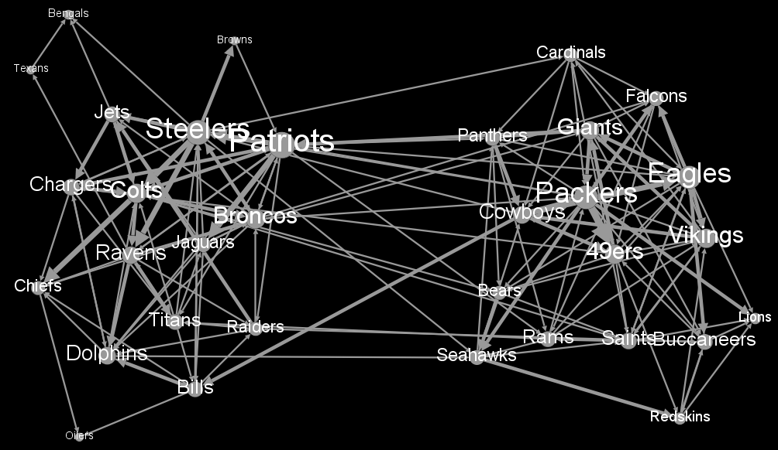
Playoff Network 1992 - 2011

Slide 6

Regular Season Network
A node for each team
Undirected edge between teams
Edge weight is the average “goodness” of that matchup
w = winner’s score, l = loser’s score
“Good” games are close and high-scoring
Selected matchup with the highest goodness

Slide 7
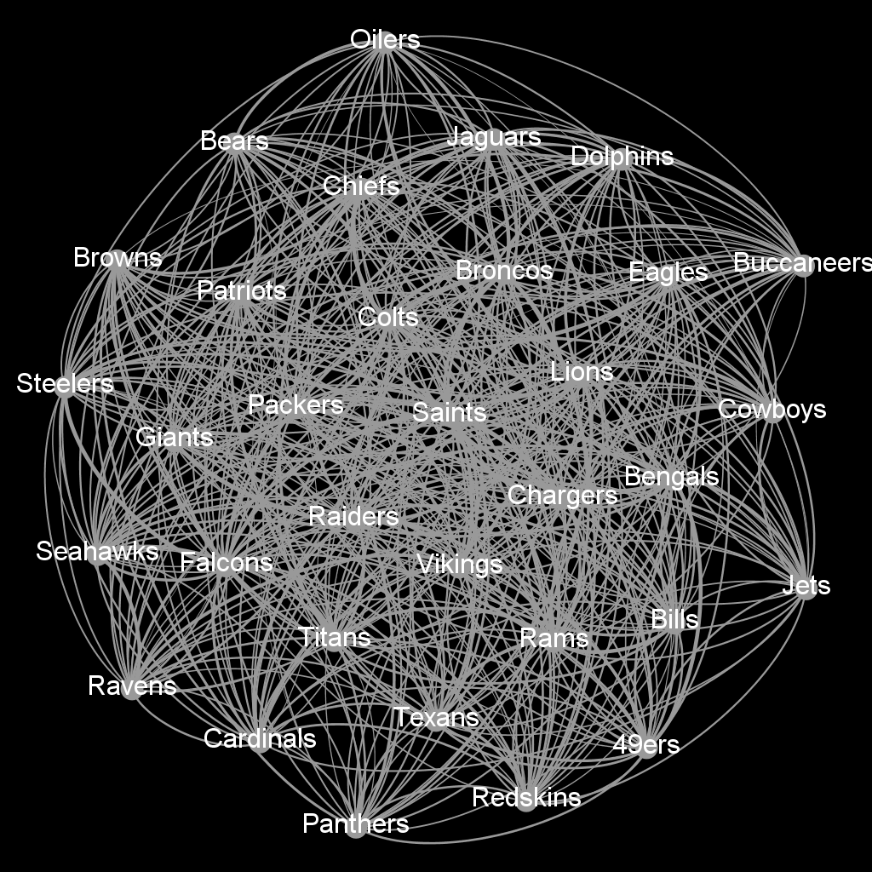
Regular Season 1992 - 2011

Slide 8
Example: Week 5 in 2011
Actual SNF matchup: Packers v Falcons
Predictions using the playoff network metrics
5-year window v 3-year window

Slide 9
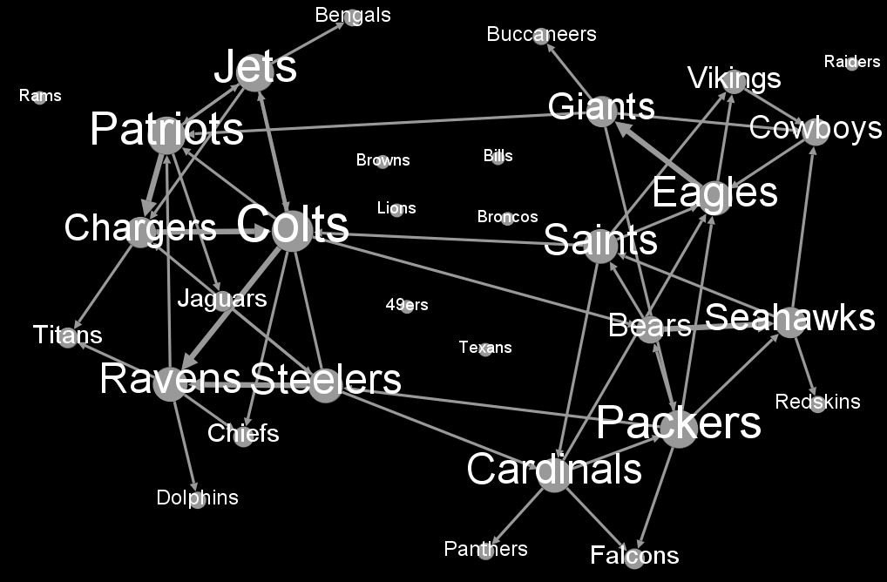
2011 5-year Graph

Slide 10
Predictions
Outdegree
Individual: Packers v Falcons
Combined: Patriots v Jets
Degree
Individual: Patriots v Jets
Combined: Packers v Falcons
Centrality
Individual: Patriots v Jets
Combined: Patriots v Jets
Strength of Tie: Patriots v. Jets

Slide 11
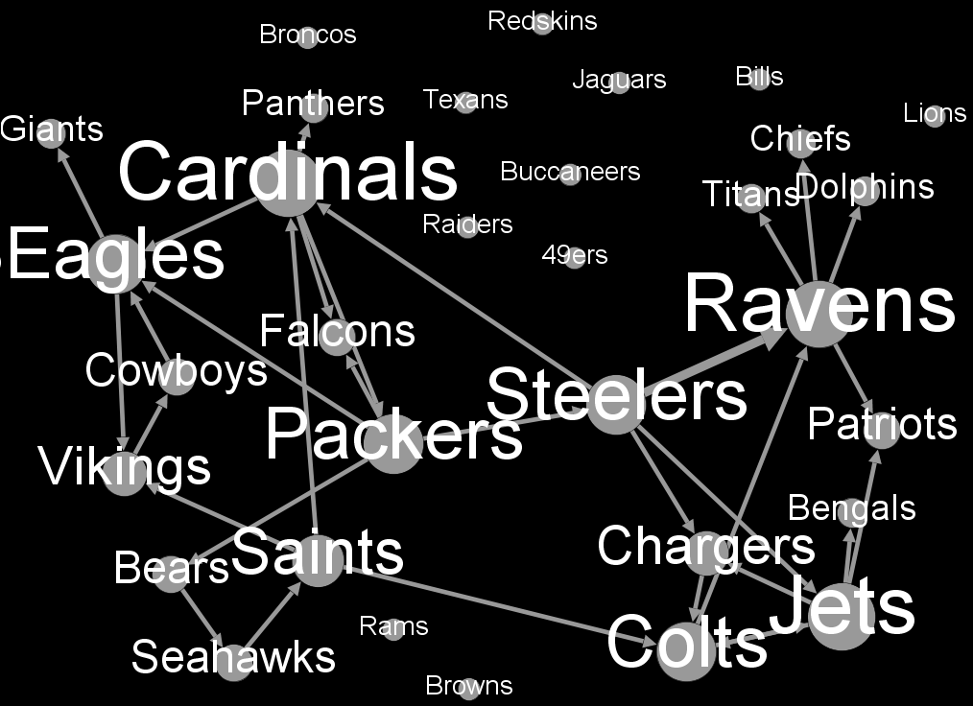
2011 3-year Graph

Slide 12
Predictions
Outdegree
Individual: Packers v Falcons
Combined: Packers v Falcons
Degree
Individual: Packers v Falcons
Combined: Packers v Falcons
Centrality
Individual: Packers v Falcons
Combined: Packers v Falcons
Strength of Tie: Packers v Falcons

Slide 13
Results

Slide 14
Best Results for each metric

Slide 15
Discussion
The network metrics I used are not good predictors of SNF matchups
Other factors
Reunion games
Rivalry games
Special occurrences
e.g. Manning brothers matchup
Flex Scheduling

Slide 16
Questions?

